Slide 1
Use Intelligent Edge to Protect TDM/Analog Investment & Secure IP Voice
Gordon Eddy
Senior Director, Product Line Management - Enterprise Strategy and SBC Edge

Slide 2





Common Edge Challenges
Need More Bandwidth for Cloud-based Apps
Need to Secure Communications
Need to Integrate Legacy Assets
Cloud-based business apps require more bandwidth
Storage is also in the cloud
Employee productivity is tied to speed of access
Firewalls don’t protect voice well
DoS attacks are increasing
Threat vectors are growing
Business processes still tied to analog phones, etc.
May need to keep legacy PBX or contact center running
Globally, not all countries/ sites support SIP trunks
Notes:
2

Slide 3

Modern Edge Platform
Single integrated, one-box solution
UC and Contact Center certified and ready
Simplifies operations, streamlines training, and enhances efficiency in network edge implementations
Addresses growing demand for bandwidth (10G support), secure connectivity in UC and cloud-based architectures and legacy architecture migration
Router
Edge 8000
SBC
Gateway
- Designed for Cloud First Organizations

Slide 4





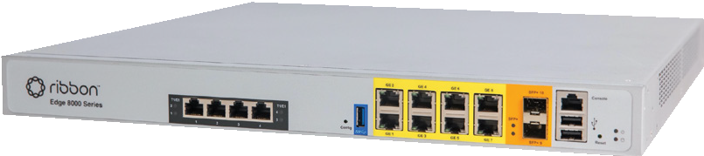


Edge 8000 Next Generation Edge
Edge 8100: SBC & Routing
Edge 8300: SBC, Routing, & Gateways
Edge 8500: SBC, Routing, & Gateways (higher capacity) : Available Q1’2025
Internet Service Provider
IP-PBX or
IP Phones
Edge 8000
Analog Devices
State of the art hardware platform
10Gbps Routing, SBC & GW
960 sessions, 25 CPS
SIP HA Support
4 PRI and (24FXS or 22FXS/2 FXO)
Higher TDM/Analog Capacity (w/Edge 8500)
Telecom Service Provider
Legacy PBX
PC/ Laptops & Smartphones

Slide 5
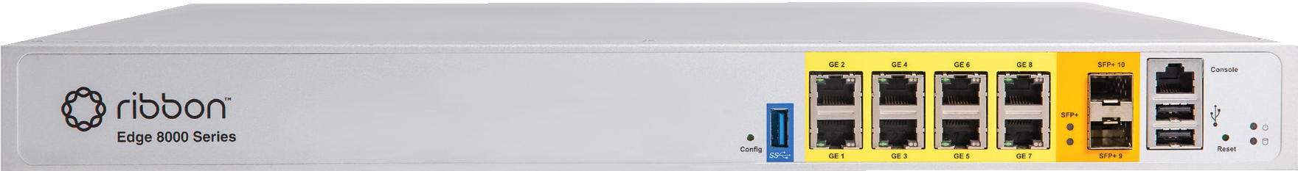
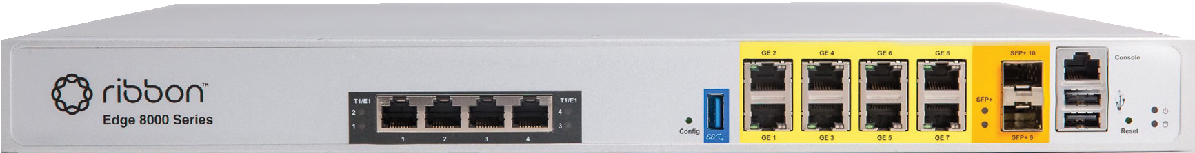

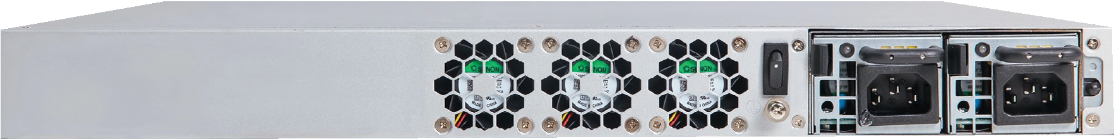
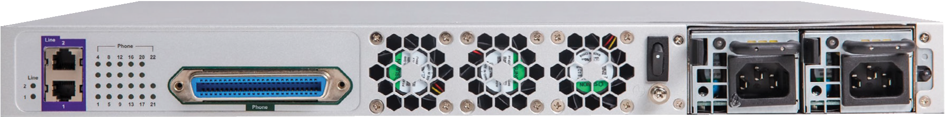
Two Edge 8000 Options – Edge 8100 & Edge 8300
Edge 8100
8x1G Switch RJ45
2x10G SFP+
Reset
Edge 8300
8x1G Switch RJ45
2x10G SFP+
Reset
Config
USB 3.0
Console 2x
Power +
Disk USB 2.0 Access
4x T1/E1 RJ-48
Config
USB 3.0
Console 2x
Power +
Disk USB 2.0 Access
Edge 8100
Edge 8300
Fans
AC or DC Power Supply
(single or dual)
2x FXO RJ-11
22 or 24 Analog FXS
(50 Pin Connector)
Fans
AC or DC Power Supply (single or dual)
Physical
  1U high
  CPU: C3758, 8-core, Onboard Atom® C3000
Regulatory
  IECEE/UL, US, IC, EU

Slide 6
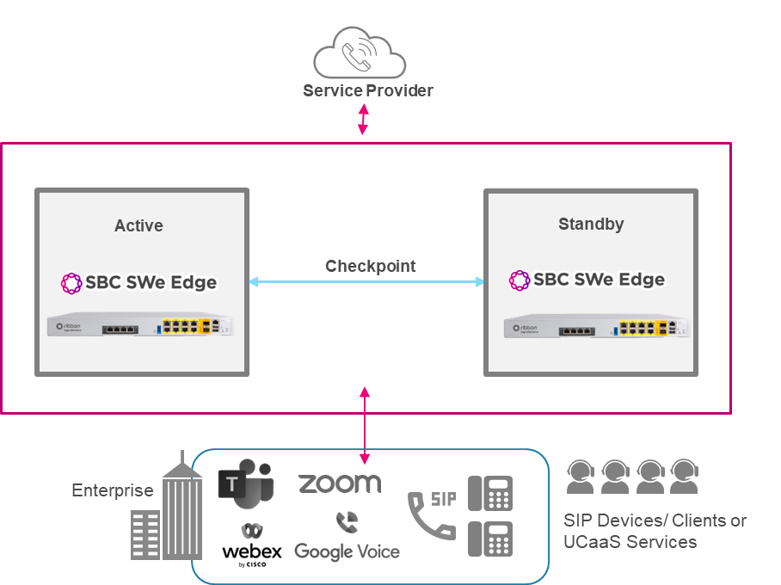
High Availability (HA) for SWe Edge on Edge 8000
Service and session continuity – mitigates software and hardware faults
SWe Edge HA
  SIP Only
  Routing HA in subsequent release
SWe Edge leverages the SBC Core HA framework, which is been in production for years
HA expands breadth of solution

Slide 7
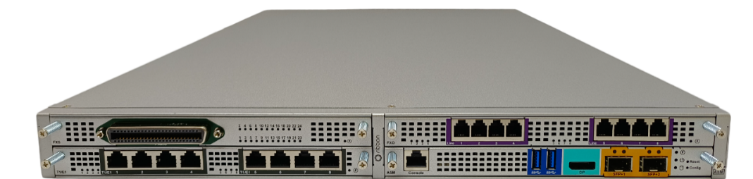
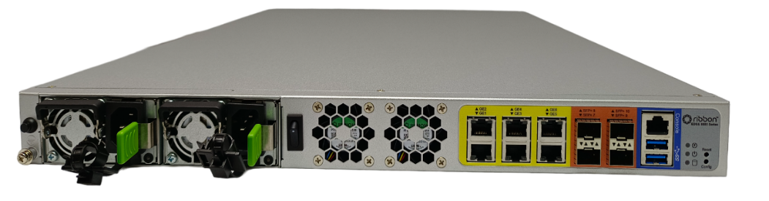
Edge 8500 – Available in Q1 2025
GA Planned for Q1 25
New member of Edge 8000 portfolio
Higher density gateway options
Greater processing power
4 slot, midplane design for physical port flexibility
Optional ASM processor card
Scales to meet SBC 2000 use cases
  Superior SBC scale with HA
  Greater CPS
  Modern, powerful platform
Also available as a FIPS compliant RedHat OS variant for key vertical markets

Slide 8
Edge 8500 - Design Parameters
GA Planned for Q1’ 25
1RU with a 4-slot midplane design
10G Router
10G SFPs supports wide variety of industry standard SFPs
Planned FIPS 140-3 compliance and JITC certification
Teams, Zoom & Webex certification
Redundant field replaceable and hot swapable PSUs: AC–Single, AC–Dual, DC-Dual
Homologation
Multiple Expansion Cards (4 slots total)
  8x T1/E1/PRI card (up to 2 per chassis)
  8x FXO card (up to 2 per chassis)
  24x FXS card (up to 4 per chassis)
  ASM card (1 per chassis – must be in Slot 4)
  All slots support field replaceable (not hot swapable) PRI (T1/E1), FXS/FXO cards

Slide 9

Edge 8000 – Three Target Markets
Modern Alternative to SBC 2000 and Associated Use Cases
  Greater scale – + 400 sessions capacity on SBC
  SBC High Availability
  Addition of a full edge router
Critical Infrastructure – Utilities, Govt Agencies, Defense, Financial Institutions
  Created hardened RedHat variant of Edge 8300 for highly secure deployments
  Added VTP & V.150 support
  Beginning process for US Military “JITC” certification (expect completion in late Q4 2024 or Q1 2025)
Edge Router - complementary multiservice edge router packaged with Neptune for circuit emulation use cases
  Added support for Edge 8000 for network topology and alarms in Muse 9.0 - GA’d in Oct. 2024

Slide 10



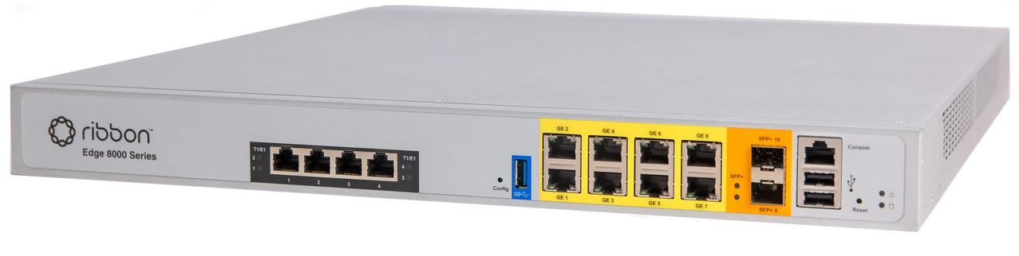

Edge 8000: Enterprise Use Case - eSBC
SIP Trunking – TDM PBX
UCaaS and Hosted PBX
Edge 8000 supports circuit speeds of 10Gbps bidirectional
Edge 8300 provides Ethernet, Optical, T1, FXS and FXO in every device
Hardened SWe Edge = > Fully interop tested to insure trunk/PBX compatibility
SWe Edge VNF provides Teams, Zoom, Webex and Google Voice certifications
SIP
SIP
PRI
IP PBX
TDM
SIP

Slide 11





Edge 8000: Enterprise Use Case – Branch Office
Branch Office
Multi-services gateway router that combines voice security, routing, traffic shaping, media management, with up to10 Gbps
WAN/LAN interface flexibility
Optional FXS, FXO, PRI interfaces
Easy Config Wizard for SWe Edge VNF
DMZ Servers (FW, SSL, etc.)
Router/ MPLS PE
1GE/10GE LAN
Primary
FXO
IP WAN
IP PBX
FXO
FXO
Secondary
IP Phones
LAN Switch
Analog Phones
Internet
Smartphones
Fax
Wi-Fi APs
Laptops
Laptops

Slide 12
Edge 8000 and Neptune: TDM/DACS Replacement Use Case
CSP Voice Hub Complex
TDM XC Services on Neptune
DHCP-VTEP-a
Edge 8100
Local device cross-connect
Intra-CSP cross-connect
Remote CO cross-connect
Remote CSP/CO cross-connect
Voice-Hub-a
Voice TDM Ckts
Internet
NPT 1300
DHCP Clients
ELAN
Voice-Hub-b
Voice Hosts
DHCP-VTEP Services on Edge 8100
IP WAN
GCP
VXLAN tunnel end-point (VTEP)
DHCP Server – IP Address Assignment for Clients
XC-a
XC-a
NPT 1300
XC-a
NPT 1XXX
NPT 1XXX
NPT 1XXX
DHCP-VTEP-b
Edge 8100
CSP XC

Slide 13







Edge 8000 and Neptune: TDM/POTS Modernization Use Case
VOIP SIP
TDMoIP/CES
TDM PBX
SIP
CPE SIP Gateways
H.248
GCP
Service Provider
Central Office
SIP
T1
Neptune | MPLS Transport Performs CES Services
Edge 8300 | Intelligent Edge Gateway
NPT
1250, 1300, 1800
L2-ASE
MPLS
SIP
T1
NPT 1022
SIP
TDM PBX
L2 Access
L3 Access
TDMoIP/MPLS
Customer Premise
Aggregation and
CES for TDM Modernization
GCP
POTS Only
POTS
H.248
Ethernet and IP trunks
IP, VLAN, NAT
API, SNMP, Syslog

Slide 14








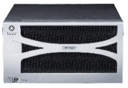






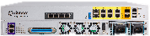





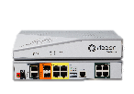


Ribbon SBC Portfolio
Microsoft Certified for Direct Routing
Zoom Certified for BYOC
Webex Local Gateway Certified
Google SIP Link Certified
Service Provider Core
75,000 Sessions
SIP (up to 10 GB)
High Availability
150,000 Sessions
SIP (10 GB)
High Availability
“Unlimited” Sessions
Virtual & Cloud
Azure, AWS & Google
GPU, CPU & DSP Transcode
Enterprise
Edge
1,000 Sessions
Virtual & Cloud
CPU Transcode
Teams SBA option
Azure & AWS
192 or 600 Sessions
Teams SBA option
FXO/FXS options
960 Sessions
CPU Transcode
FXO/FXS options
10 Gbps edge routing
Service Provider
Edge
2 or 4 Port ATA
Field upgradable
Centrally managed
Zero Touch Provision
300 Sessions
FXO/FXS options
PoE options
Zero Touch Provision
500 Sessions
FXO/FXS options
LTE 4G Option
Zero Touch Provision

Slide 15
Thank You

